Slide 1
Testing, Projects
attendance code: 6615
Workshop 5
Ruzanna Chitchyan, Jon Bird, Pete Bennett
TAs: Mitch Lui, Craig Barnfield, Kira Clements, Ollie Myers
Notes:
Simon

Slide 2
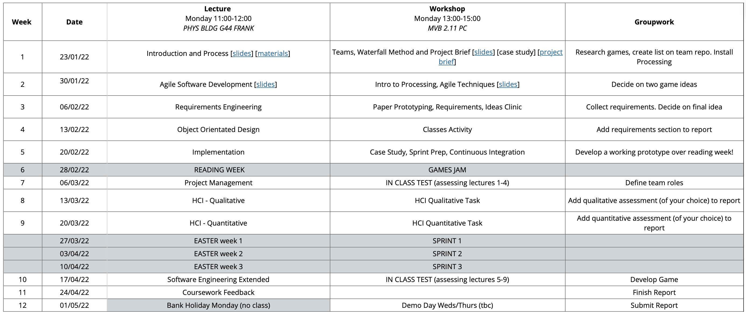

Slide 3

Today’s Workshop
Testing (50 mins)
Mock Test (15 mins)
Game Jam Prep (15 mins)
Summer Project (15 mins)
Homework. Your team should now have one game idea. Develop a working prototype *(MVP) over reading week!

Slide 4
Testing

Slide 5
To do
1. Apply Equivalence Partitioning to define tests for Triangle Problem
2. Apply Equivalence Partitioning to define tests for UK Tax Allowance Calculator

Slide 6
Testing Triangle Problem

Slide 7
Triangle Problem
Given a triple of positive integer values (that is 3 integers greater than zero), the program determines whether they could represent the side that form a triangle. If they can, it classifies the triangle a scalene (sides of different length), isosceles (two equal sides) or equilateral (three equal sides). If the triples contain negative or zero values, print an error message.
To do:
Derive tests for black box testing (use equivalence partitioning)
Hint: the sides are not independent inputs, use triples

Slide 8
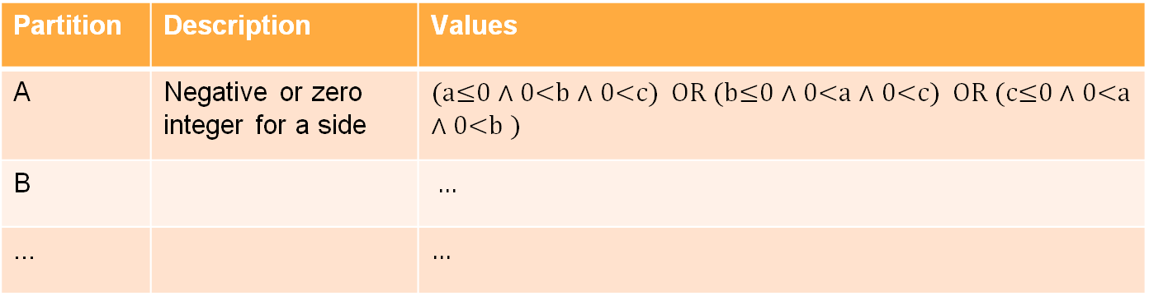
E.g.: Triangle Problem: sides a, b, c
Partition | Description | Values
A | Negative or zero integer for a side | (a≤0 $∧$ 0<b $∧$ 0<c) OR (b≤0 $∧$ 0<a $∧$ 0<c) OR (c≤0 $∧$ 0<a $∧$ 0<b )
B |  | …
... |  | $$…$$

Slide 9
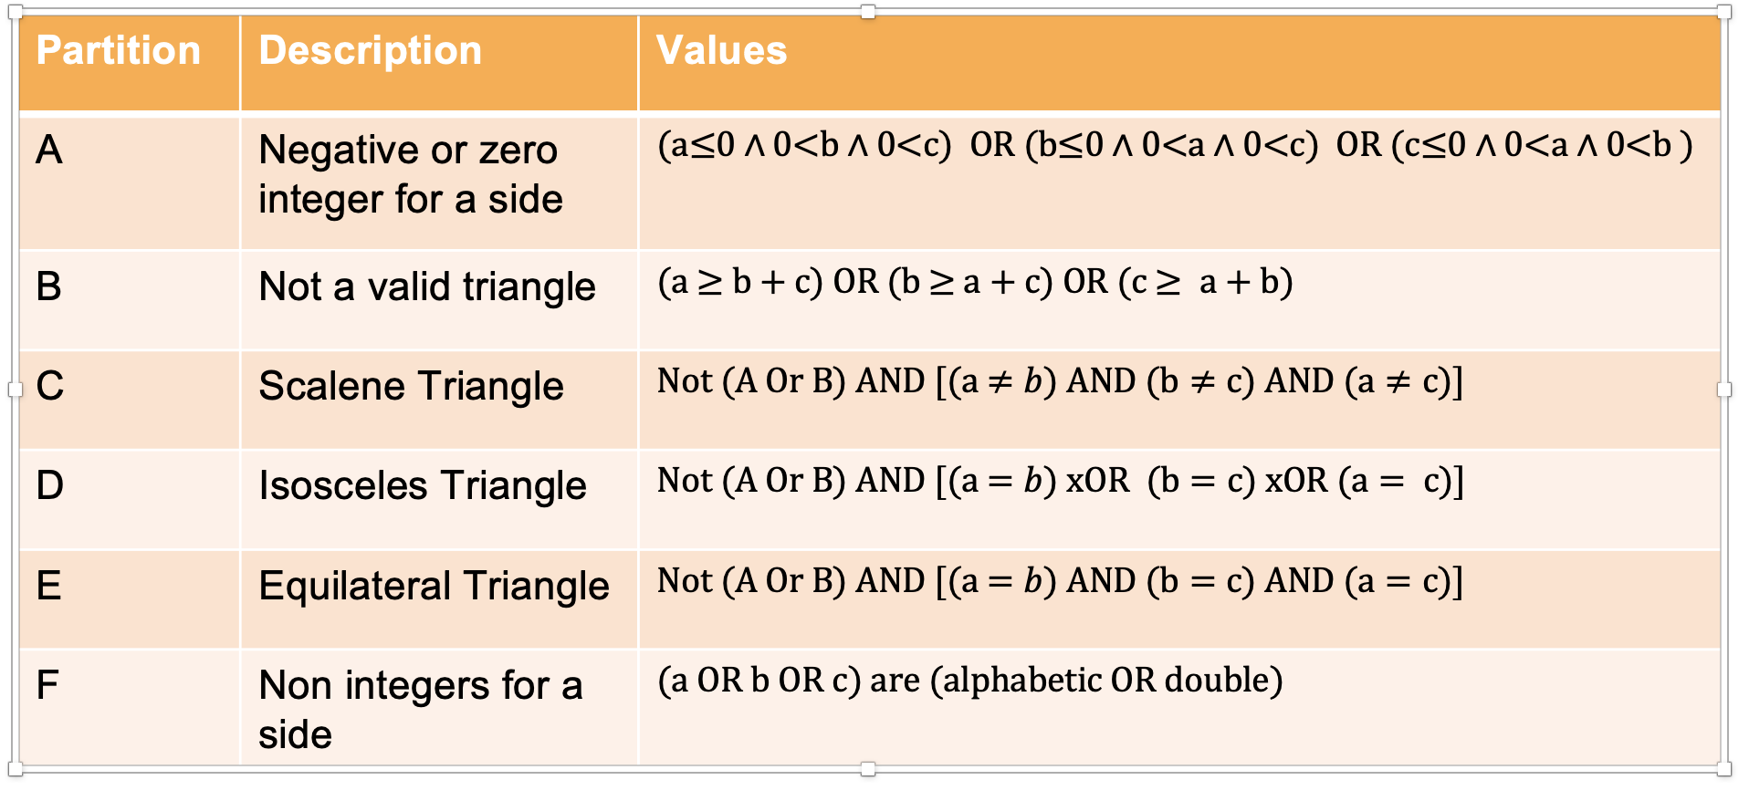
Solution - Triangle Problem: sides a, b, c

Slide 10
Testing a UK Tax Allowance Calculator
https://www.gov.uk/income-tax-rates/current-rates-and-allowances

Slide 11
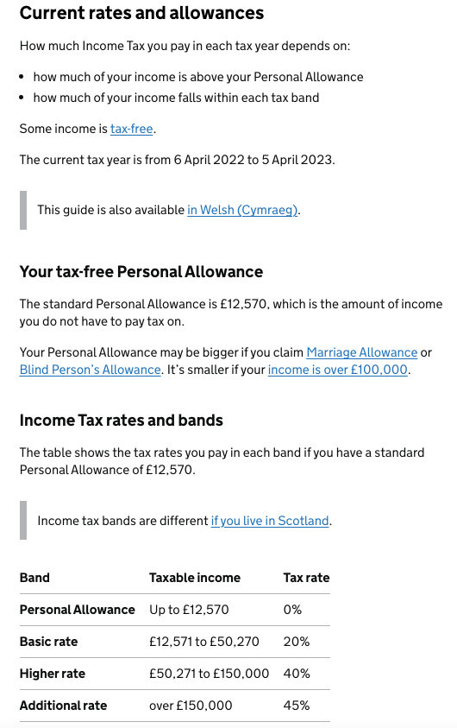
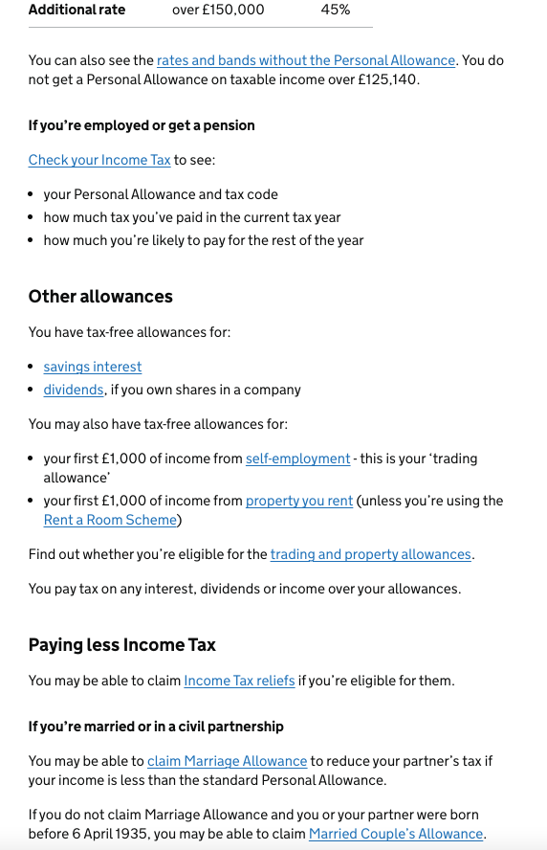

Slide 13
E.g.: Possible Categories to start with
Use Equivalence Partitioning approach, follow the steps to
come to a set of partitions, e.g.
2. See what constraints there are between the categories
3. Start defining test cases
Category | Description | Values
A | In Personal Allowance | pay ≤ 12,570
B | …
… | …

Slide 14
Solution - Possible Categories:
Category | Description
A | In Personal Allowance | pay ≤ 12,570
B | In Basic Rate | 12,570 < pay ≤ 50,271
C | In Higher Rate | 50,271< pay ≤ 100,000
D | In Additional Rate | Pay > 150,000
E | Above 100k , sub additional rate | 100,000 < pay ≤ 150,000
F | Blind | Blind = true
G | Not Blind | Blind = false
H | Married | Married = true
I | Not Married | Married=false

Slide 15
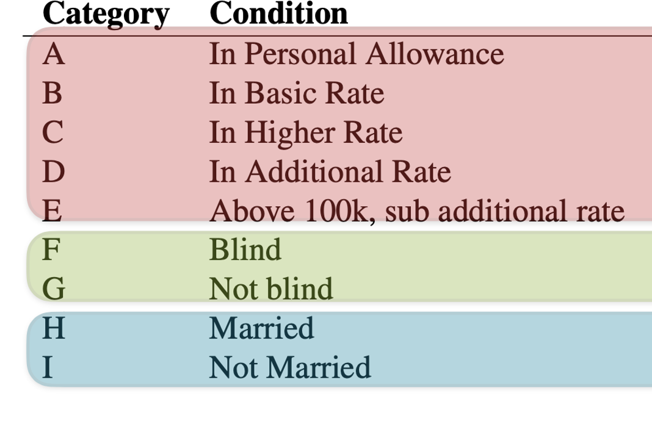
Solution - Generating Tests by Combining Categories:
Several categories cannot be combined with each other

Slide 16
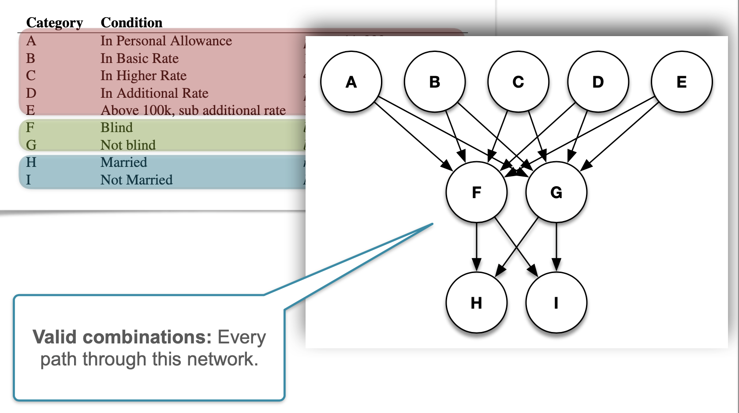
Solution - Every Possible Combination:

Slide 17
Mock Exam

Slide 18
Game Jam Prep
Do you have one clear idea for a game?
Is it either entirely novel or have a distinct twist on an existing game?
Have you identified three challenges?
Explain your idea to one of us over the next 15mins
We will give you a thumbs up before you begin development with the games jam!

Slide 19
Summer Projects

Slide 20
Timeline
Project list released in two weeks time: Monday 6th March
6 weeks before selection finalised
Individual projects, contact supervisor directly, use form to confirm project
Tuesday 7th – Project clinic with ILO
Tuesday 14th – Group matching session
Tuesday 21st – Group preference form
Selection process finalized by end of Easter holidays: 14th April
Project starts Monday 5th June
Hand-in Tuesday 5th September
Viva the week after
RESITS:.
If you are doing any resits from TB1, sorry but you can’t select a group as the risk is too high!
With one resit in TB2, you may appeal to continue.

Slide 21
Individual Projects
Work with an academic supervisor on a novel project
Choose if you plan to do a PhD or go into academia
It is up to you to contact supervisor and for them to agree they will supervisor you
Can I choose my own project? Yes, you can approach a supervisor in an area you are interested in and they may be able to supervise you in a project you suggest.
100% on the project report (up to 50 pages body)
Optional viva/demo for second marker
Note: last year individual and group projects had a mean average grade that was less than 1% between each other

Slide 22
Group Projects
You will be working with a client / industry partner
Choose if you plan to go into software development.
5 people in a group, some groups of 4
How do I choose a group? … How’s your SoftEng team working out? This could be a good starting point. We will be running a group matching session on Tuesday 14th to help you out.
50% group report, providing details of the project motivation, design, implementation and evaluation.
30% individual report, providing descriptions of and reflections on the student’s own contribution to the project and their personal view of the project, its outcomes and future work.
20% final group presentation, showcasing and demonstrating the outcomes of the project, and involving contributions from all team members.

Slide 23


homework / groupwork
Plan a game jam to take place of reading week.
We don’t mind if this is in person, or online, just make sure you set aside enough time!
We want your team to produce a playable MVP by the end of reading week. Keep it simple, make sure it’s playable!

